Slide 1
Face Detection Implementation
FIZA BEG
2021H1120023U
BITS Pilani Dubai Campus

Slide 2
INTRODUCTION
Face detection is a problem in computer vision of locating and localizing one or more faces in a photograph.
Locating a face in a photograph refers to finding the coordinate of the face in the image, whereas localization refers to setting the boundaries of the face, often via a bounding box around the face.
Given a photograph, a face detection system will output zero or more bounding boxes that contain faces. Detected faces can then be provided as input to a subsequent system, such as a face recognition system.

Slide 3
FACE DETECTION WITH OPENCV
Feature-based face detection algorithms are fast and effective and have been used successfully for decades.
The AdaBoost model is used to learn a range of very simple or weak features in each face, that together provide a robust classifier.
A modern implementation of the Classifier Cascade face detection algorithm is provided in the OpenCV library. This is a C++ computer vision library that provides a python interface. The benefit of this implementation is that it provides pre-trained face detection models, and provides an interface to train a model on your own dataset.

Slide 4
IMPLEMENTATION
Opencv can be installed by the package manager on your system or via pip.
sudo pip install opencv-python
Once installation is complete, we can check whether it is installed correctly. This can be done by checking version number of the opencv installed.
Import opencv. → import cv2
Print the version of cv2 → print(cv2.__version__)
By this line of code you will get the version of the opencv.

Slide 5
The constructor can take a filename as an argument that specifies the XML file for a pre-trained model.
OpenCV provides a number of pre-trained models as part of the installation.
Download a pre-trained model for frontal face detection from the OpenCV GitHub project and place it in your current working directory.
Once installation is complete load the pre-trained model into your file.
classifier = CascadeClassifier('haarcascade_frontalface_default.xml')

Slide 6
The photo can be loaded using OpenCV via the imread() function.
pixels = imread('imageFDAI.jpg')
The model can be used to perform face detection on a photograph using detectMultiScale() function.
bboxes = classifier.detectMultiScale(pixels)
Each face is detected and have bounding box.
Each box lists the x and y coordinates for the bottom-left-hand-corner of the bounding box, as well as the width and the height.

Slide 7
A rectangle can be drawn for each box directly over the pixels of the loaded image using the rectangle() function that takes two points.
x, y, width, height = box
x2, y2 = x + width, y + height
# draw a rectangle over the pixels
rectangle(pixels, (x, y), (x2, y2), (0,0,255), 1)
Then plot the photograph and keep the window open until we press a key to close it.

Slide 8
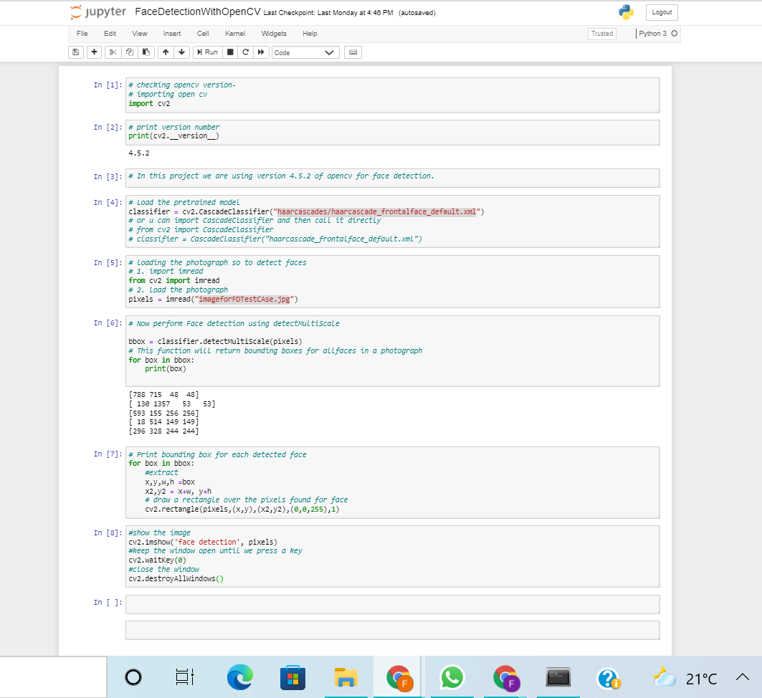

Slide 9
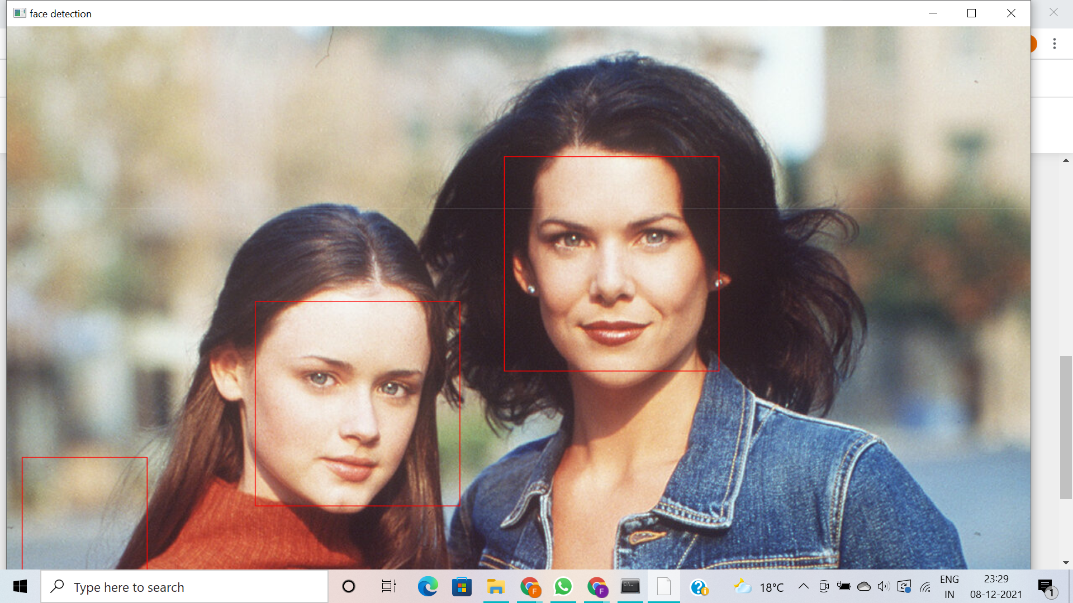

Slide 10
Face Detection With Deep Learning
Deep Learning was used in place of opencv to overcome the accuracy. OpenCv wasn’t that accurate.
A number of deep learning methods have been developed and demonstrated for face detection.
The most popular approach is called “Multi-Task Cascaded Convolution Neural Network” or MTCNN.

Slide 11
MTCNN is popular because it achieved then state-of-art results on a set of dataset and also because it is able to recognise eyes and mouth called as landmark detection.
The model is called a multi-task network because each of the three models in the cascade (P-Net, R-Net and O-Net) are trained on three tasks: face classification, bounding box regression, and facial landmark localization.
The three models are so connected that the output of first model is input of the second model.
The best-of-breed third-party Python-based MTCNN project is called “MTCNN” by Iván de Paz Centeno, or ipazc.

Slide 12
CONTINUED…
Install mtcnn library using pip command.
pip install mtcnn
Check whether the library is installed correctly:
~ via pip
pip show mtcnn
~ via Python command
print(mtcnn.__version__)

Slide 13
An instance of the network can be created by calling the MTCNN() constructor.By default, the library will use the pre-trained model.
Once the model is loaded then it can be used to detect faces in photographs using detect_faces() function.
We can draw bounding box on faces using function named draw_image_with_boxes() that shows the photograph and then draws a box for each bounding box detected.

Slide 14


Slide 15
If you want to extract the detected faces and pass them as input then you can do it by extracting the pixel data directly out of the photograph.
x1, y1, width, height = result['box']
x2, y2 = x1 + width, y1 + height
# extract face
face = data[y1:y2, x1:x2]
Extract each face and plot them as separate subplots and easily save them to file. The draw_faces() extracts and plots each detected face in a photograph.

Slide 16
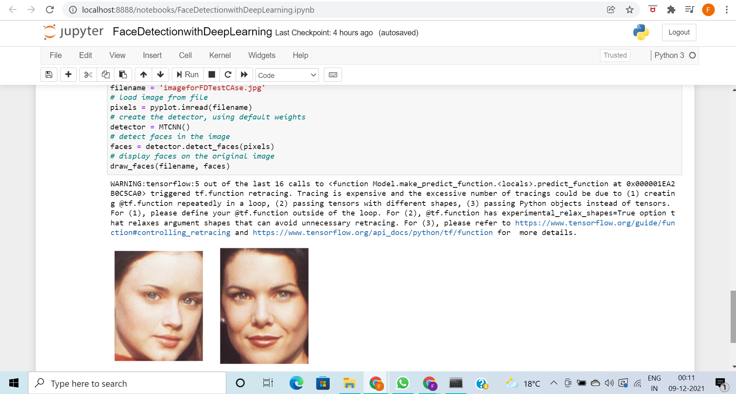

Slide 17
Conclusion
Face Detection can be achieved using OpenCV and Deep Learning method.
OpenCV is useful in navigation,medical industry,biometric etc.
Deep learning is more accurate than OpenCV and is more preferred in real time system.
Deep Learning is popular because it achieved state-of-art result on number of dataset.
Deep learning is used in crowd surveillance, human-computer interaction, facial feature extraction marketing.

Slide 18
Reference
https://machinelearningmastery.com/how-to-perform-face-detection-with-classical-and-deep-learning-methods-in-python-with-keras/
https://www.youtube.com/watch?v=oXlwWbU8l2o
https://www.youtube.com/watch?v=PLKLsPDZ1t0
https://drive.google.com/file/d/1pomC9Zw178nxgNOrpemaQfSH8rSVyMBD/view
https://docs.opencv.org/3.4/db/d28/tutorial_cascade_classifier.html

Slide 19
THANK YOU !

